Slide 1

ONLINE BUS PASS SYSTEM
Software Engineering and Project Management – 18CSC206J
NIKITH KUMAR S –RA1911003020480
VIGNESH P –RA1911003020468
ROHITH S – RA1911003020474

Slide 2
ABSTRACT
The project entitled “Online Bus Pass System” is developed using loginpage.php as Front end and MYSQL Server as back end. Bus pass registration is useful for passengers who are facing problems with the current manual work of bus pass registration and renewal. His/her renewal or registration can be done through credit card. In the manual system the user has to go on particular date and time if they fail then the renewal cannot be done. This online bus pass registration application will help candidates to save their time and renewal bus pass without standing in a line for hours near counters. Initially uses need to register with the application by submitting their details through online. The administrator will verify the candidate details and if they are satisfied they will approve bus pass. The candidate can login with their username and password and renewal is performed. The renewal process is carried by paying the money using the credit card. The candidate can give their valuable feedback for further enhancement of this project.

Slide 3
OBJECTIVE
The main objective of this project is created to provide “safe, reliable, saving, efficient and affordable” services for user. This idea would help the user in a better way. As per the previous system the user had to do each and every process manually, but this system helps user to make the work bit faster. The user can then take print out of this bus pass from their mail id and use them. The bus pass will be differ for different types of users. In this bus pass, all the required details such as candidate name, address, date of birth, mail id, name of the school(government/private), validity period, amount paid (free for government school students) and photo copy of the candidate are provided. Instead of school details, working organization details will be provided in employees bus pass. The renewal process can be done either monthly or yearly as per user wish. Based on that renewal period amount will be deducted.

Slide 4
WORKFLOW DIAGRAM:
LOGIN
USER
ADMIN
YES
NO
NO
YES
HOME PAGE
REGISTER PAGE
REGISTER PAGE
HOME PAGE
MANAGE USER DETAILS
MANAGE USER DETAILS
MANAGE PASS DETAILS
MANAGE BUS DETAILS
PAYMENT
MANAGE PASS DETAILS
LOGOUT

Slide 5
COST ESTIMATION:
Resource Requirements | Cost
Advertisement | Rs.3000
Visual Studio | Open Source
Server | Rs.500
TOTAL | Rs.3500
MODULE DESCRIPTION:
Register Module:
In this the user has to give complete details about him\her to create a new account using their Mail ID.
Verification Module:
After registration an verification link has sent to user’s registered mail Id. After verified, User can access the account using their registered mail id.
Pass Generation:
After providing all the necessary details like photo, contact number, address’s proof etc., the details will be submitted to the admin. The admin verifies

Slide 6
the details and authenticate them. If the admin approves the user as trusted one then the bus pass will be generated and send to the user’s mail.
Renewal Pass:
User can login to his account for the renewal of bus pass. User has to enter the necessary details. Then the payment process will be carried out. Once the process is completed the user bus pass will be renewed automatically and send to user’s mail
Payment Module:
User can pay the amount for the bus pass through the credit card. They can also pay through net banking and other online payments. The amount paid through online must be secure.

Slide 7
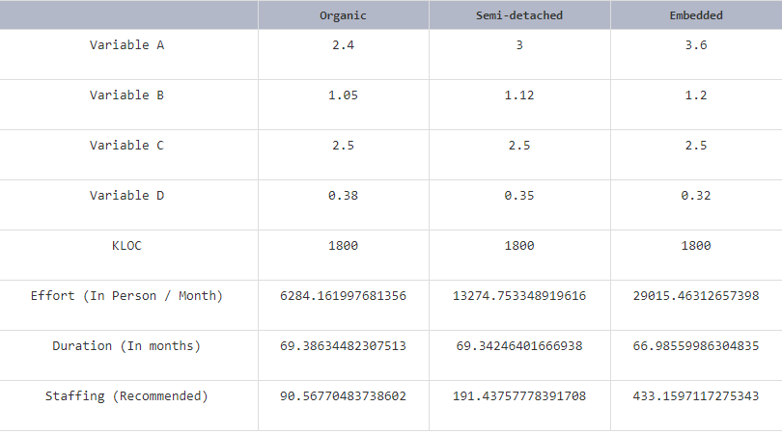
COCOMO Model:
Number of Lines of coding: 1800 Lines

Slide 8
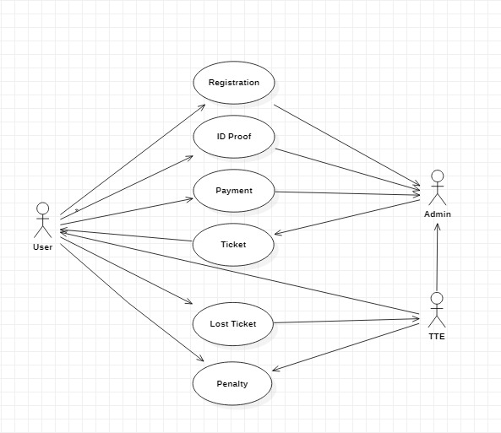
USE CASE DIAGRAM

Slide 9
STATECHART DIAGRAM
START
Registration
NO
REGISTER?
NO
Login
VALID?
Manage Details
Upload Proof
Apply For Pass
Generate Pass
Renewal Pass
Logout
END

Slide 10
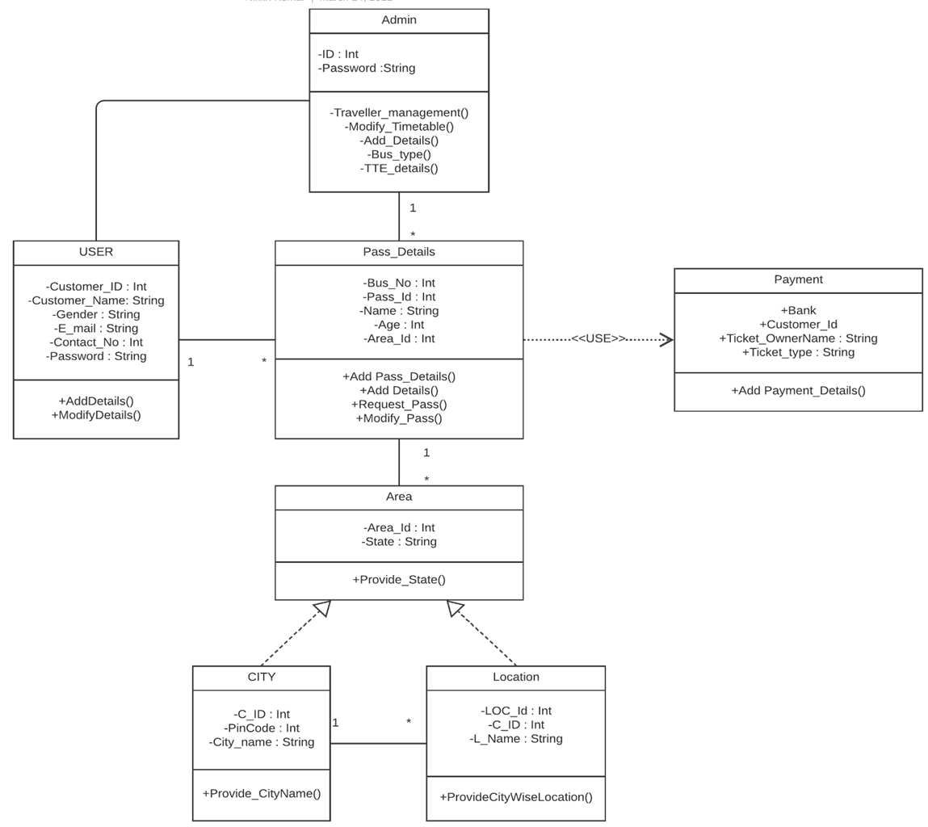
CLASS DIAGRAM

Slide 11
MANUAL TESTING
TEST AREA | INPUT | TEST DESCRIPTION | RESULT
Login Module | Login username and password | Permits the user To enter into the Website. | Tested
Registration Module | User details(Name, Phone Number, Email ID, etc..) | Saves the Registered user details To MYSQL Database | Tested
Pass Generation | Admin generates the Bus pass to customer | Sends the message to customer | Tested

Slide 12
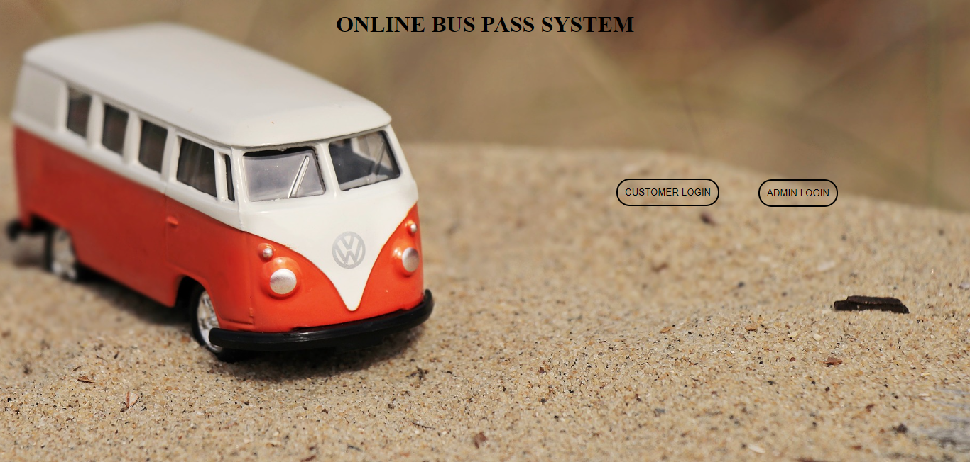
SCREENSHOTS

Slide 13
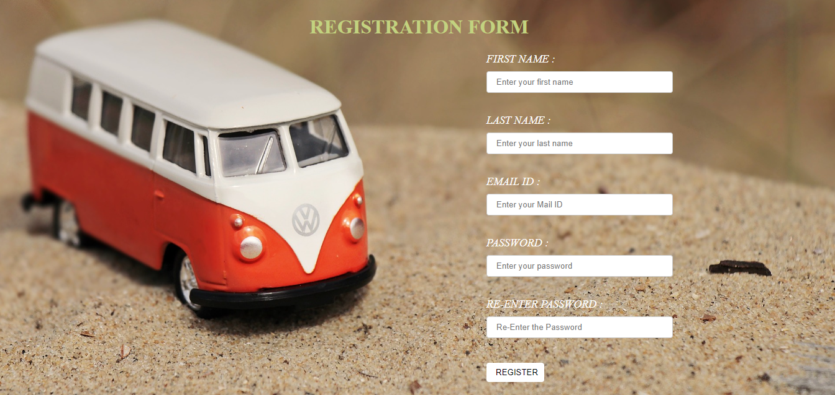

Slide 14
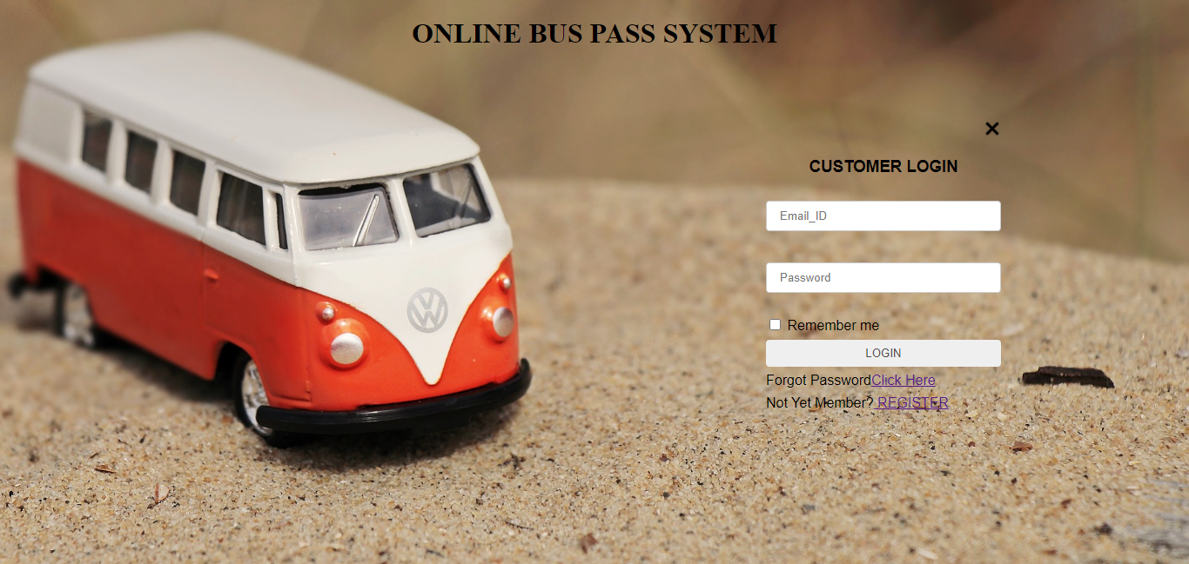

Slide 15
CONCLUSION:
At the Completion of this project we come to know that this system is useful for students and passengers who want to generate the pass from online. But there is a one bug about to paying fees online because generally the village students and passengers do not have online banking facility so this problem is occurs for state bus pass. But this is useful for city bus pass systems and metro train pass systems for big cities.
REFERENCES:
https://www.google.com
https://www.w3schools.com/php/default.asp
https://stackoverflow.com
http://www.hyderabadbusroutes.in/show-buses/all
SQL server tool kit

Slide 16
THANK YOU

